Slide 1


MAULANA AZAD NATIONAL INSTITUTE OF TECHNOLOGY BHOPAL
MINOR PROJECT
ON
“ONLINE FRANCHISE MANAGEMENT SYSTEM”
DEPARTMENT OF MATHEMATICAL & COMPUTER
APPLICATIONS
MCA THIRD SEMESTER
2015-2018
SUBMITTED BY –
AJAY KUMAR PRAJAPATI
(152120079)
RAJKAPOOR VISHWAKARMA (152120069)
CHANDANI VERMA
(152120060)
UNDER THE GUIDANCE OF –
Prof. AMIT BHAGAT
Prof. DIPTI CHAUHAN

Slide 2
ACKNOWLEDGEMENT
The success and final outcome of this project required a lot of guidance and assistance from many people and we are extremely fortunate to have got this all along the completion of our project. Whatever we have done is only due to such guidance and assistance and we would not forget to thank them.
We express our specials thanks to Prof.Sujoy Das, Prof. Amit Bhagat and Prof. Dipti Sisodia, who have encouraged and helped me to complete my project efficiently.
We are extremely grateful to them for providing such a nice support and guidance though they had busy schedule.

Slide 3

Azenda
Introduction
Objectives
Problem Statement
Requirement Analysis , SRS
Analysis and Design
Testing Procedure
Data dictionary
Conclusion

Slide 4
INTRODUCTION
The project “Online Franchisee management system” application software (Cloud based service) is used to automate the transactions between franchisors and the franchisees.
This software must also provide real-time communication between two franchisees or the controlling office over internet.
Franchisee Management System consists of list of records about the management of the details of franchisees and issues going on and also about some products and all.

Slide 5

INTRODUCTION
Franchisee management system
Franchisor (owner of the business )
Franchise (authorization ) Franchisee (who purchases a franchise)

Slide 6
INTRODUCTION
A franchise is an authorization granted by a government or company to an individual or group enabling them to carry out specified commercial activities, for example acting as an agent for a company's products.
A franchisor is the owner of the business who grant the licence.
A franchisee is a person who purchases the franchise.

Slide 7
What is it
Normally referred to as
“Business Format Franchise”
A contractual(Bond) long-term relationship
Grant of a license to franchisee
Franchisee gets
Tried and tested product/service
Profitable proven business model to follow
Experience and know how of the wholesaler
Entitlement to use the trade name/marks
Entire package

Slide 8



Slide 9
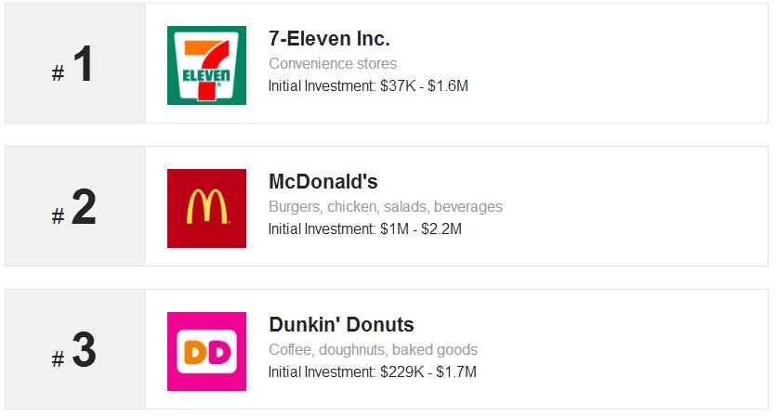
Top Rated Franchise(2017)

Slide 10
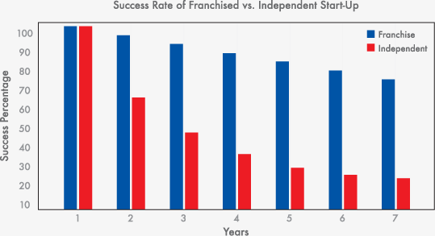

Slide 11
OBJECTIVE
The franchise management system is a application software which avoids more annual hours that need to be spend in record keeping and generating reports.
Maintaining of franchise detail in complex in manual system in terms of agreements, royalty and activities. This all have to be maintained in ledgers and books.
Franchise co-coordinators needs to visit each franchise for small information also. So that communication between franchise and franchise
co-ordinate is easy.

Slide 12
To provide accurate and entire supply franchisee as quick as possible.
This must also provide real-time communication between two frsoftware anchises or the controlling office over internet.
PURPOSE

Slide 13
Conclusion
The Goal of the “Franchise Management System “ is to bring down the work load with increased efficiency and to speed up the activities. This system will help controlling cheating between franchise and customers

Slide 14
Process Wise ERD

Slide 15
Franchisor gives franchisee
emailID
fr-name
EmailID
fename
FrID
frID
mobno
mobno
feID
State
State
City
City
Franchisors
1
N
Address
Gives
Franchisees
Address
Username
Username
Password
Password
Active
Active
Start year
dob
Joining
date

Slide 16
Franchisor provides product
Model
name
color
Password
Active
Username
Start-date
Type
Address
provides
Price
Franchisors
products
t
City
1
N
State
Staus
Mo_No.
EmailID
frID
Selling
price
fr_name
Quantity

Slide 17
Franchisee gives order
Password
Active
Username
orderID
DOJ
orderdate
Address
gives
franchisees
orders
City
1
N
State
Status
1
1
has
Mo. No.
Mo_No.
feID
orderitemID
N
Email_id
firstname
quantity
orderitems
modelname
color
type

Slide 18
Products send to delevery to orders
orderID
orderdate
Status
orders
1
Mo. No.
To
color
modelname
Type
N
chessisno
Price
t
products
1
Send To
N
Delevery
Staus
deleveryDate
Selling-price
Quantity

Slide 19
Entity Relationship Diagram

Slide 20
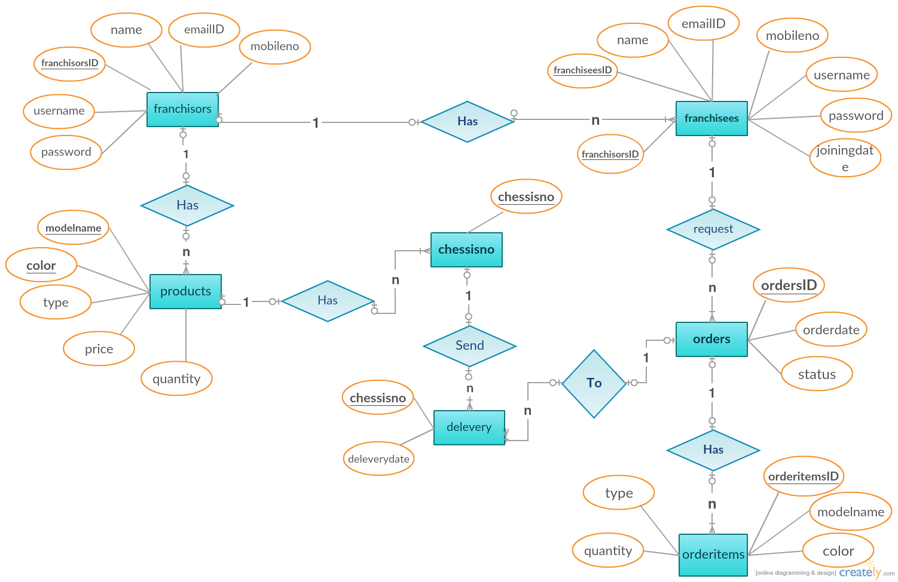

Slide 21
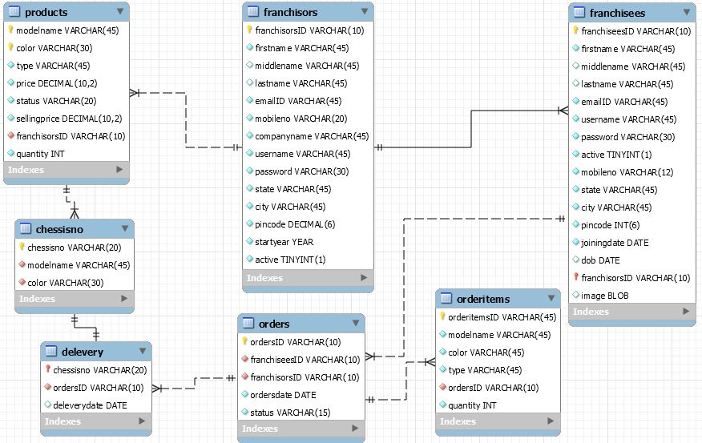

Slide 22
DATA DICTIONARY

Slide 23
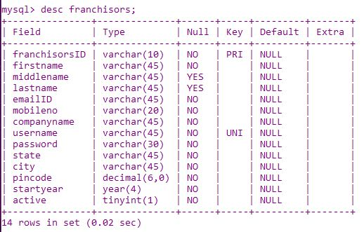

Slide 24
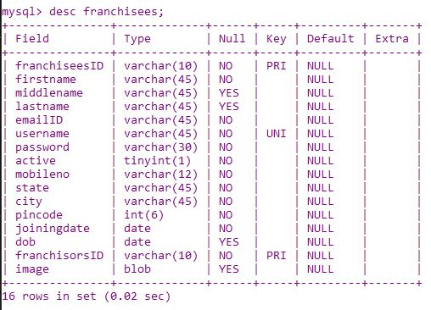

Slide 25
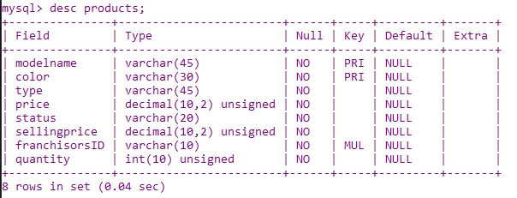

Slide 26
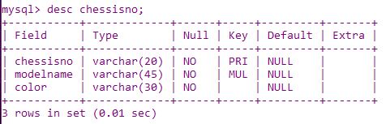

Slide 27
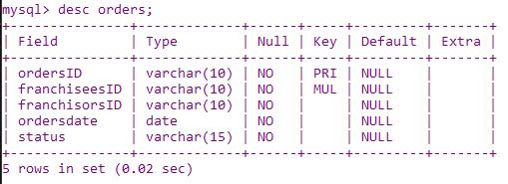

Slide 28
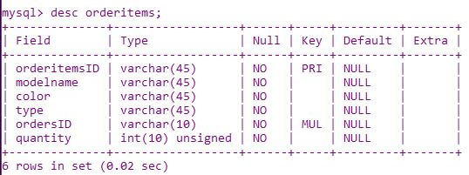

Slide 29
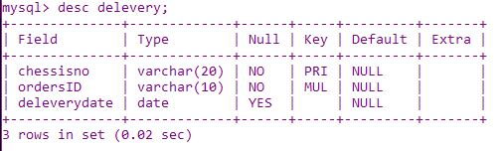

Slide 30
QUERIES

Slide 31
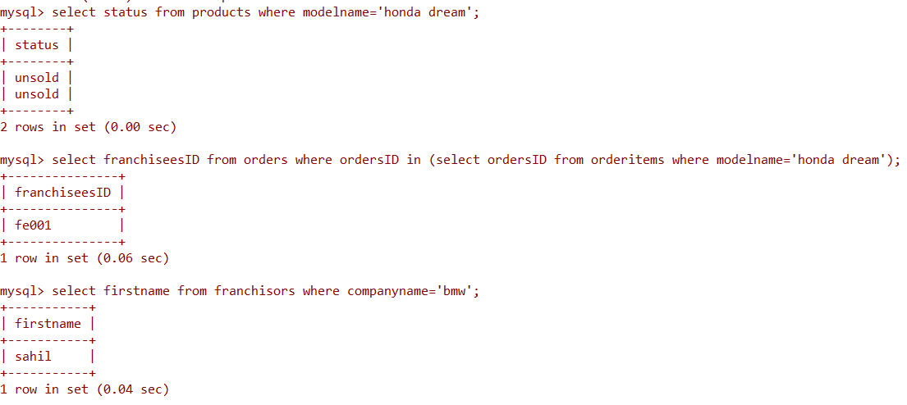

Slide 32
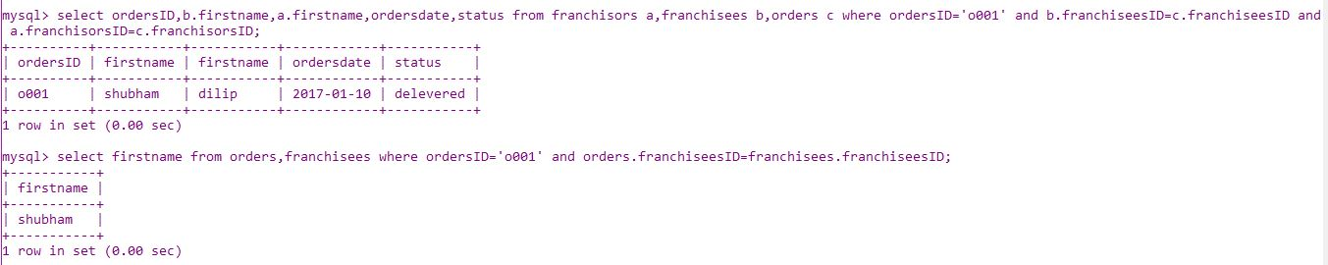

Slide 33


